Slide 1
ROBOTICS 2
Final Project
Dynamic identification of robot dynamics from motor torques w/o signs
Marco Pennese
Veronica Vulcano
a.a. 2019/2020

Slide 2
INTRODUCTION
01
PBPR ALGORITHM
02
ESTIMATING SIGNS: TREE ALGORITHM
03
RESULTS
04
Description of the project
Dynamic Identification of Robot Parameters
Torque sign estimation
Results of the experiments on 1R and 3R robot
EXTENSION
05
Extension of the algorithm to a real robot (Franka Emika Panda)

Slide 3
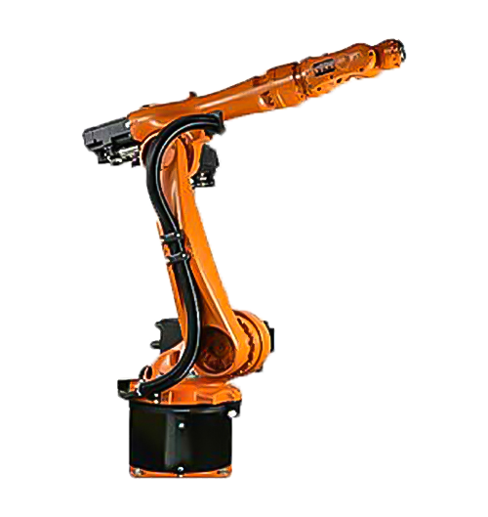
INTRODUCTION
The goal of our work is to perform the dynamic identification of a robot, estimating its
dynamic parameters/coefficients by solving an optimization problem.
We have dealt with the problem of torque sign lack, as in some real robot (e.g. KUKA KR5),
in which we can't use traditional methods for dynamic identification.
For this reason, we have developed an algorithm able to estimate torque signs so that
we could proceed with the identification using well known strategies.
We first studied a simple 1R robot under gravity; then, we moved to a more complex robot,
a 3R spatial robot.

Slide 4
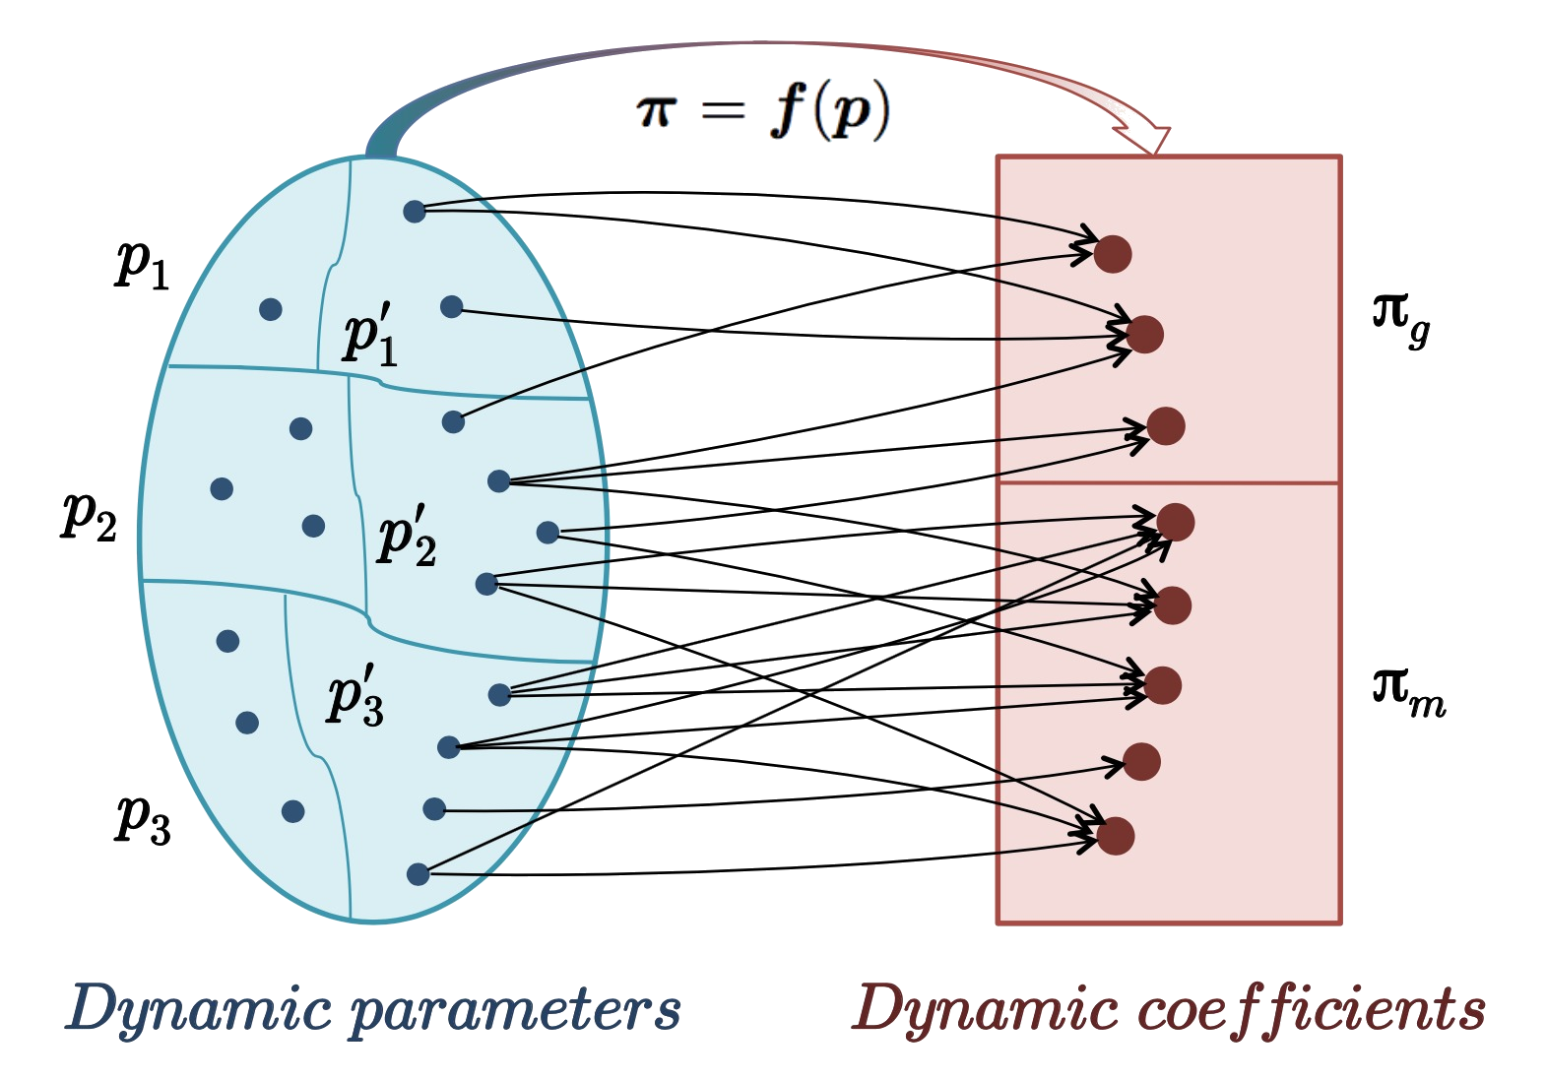

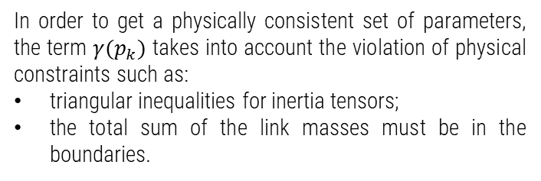
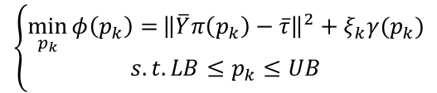
Penalty
Based
Parameters
Retrieval
Algorithm
We need to solve the following optimization problem:
In order to get a physically consistent set of parameters, the term $γ(p_{k})$ takes into account the violation of physical constraints such as:
triangular inequalities for inertia tensors;
the total sum of the link masses must be in the boundaries.
$$\left\{\begin{aligned}\min_{p_{k}}{φ\left(p_{k}\right)=}{\left\|\overline{Y}π\left(p_{k}\right)−\overline{τ}\right\|}^{2}+ξ_{k}γ(p_{k}) \\ s.t. LB≤p_{k}≤UB\end{aligned}\right.$$
The quantities $LB$ and $UB$ can always be defined based on a priori knowledge.

Slide 5



PROBLEM!
?
$$−$$
$$+$$
We cannot apply directly the PBPR algorithm because we are supposed to not to know the torque sign information, while the algorithm needs it.
So, we should devise a strategy to estimate the torque signs from what we have.

Slide 6
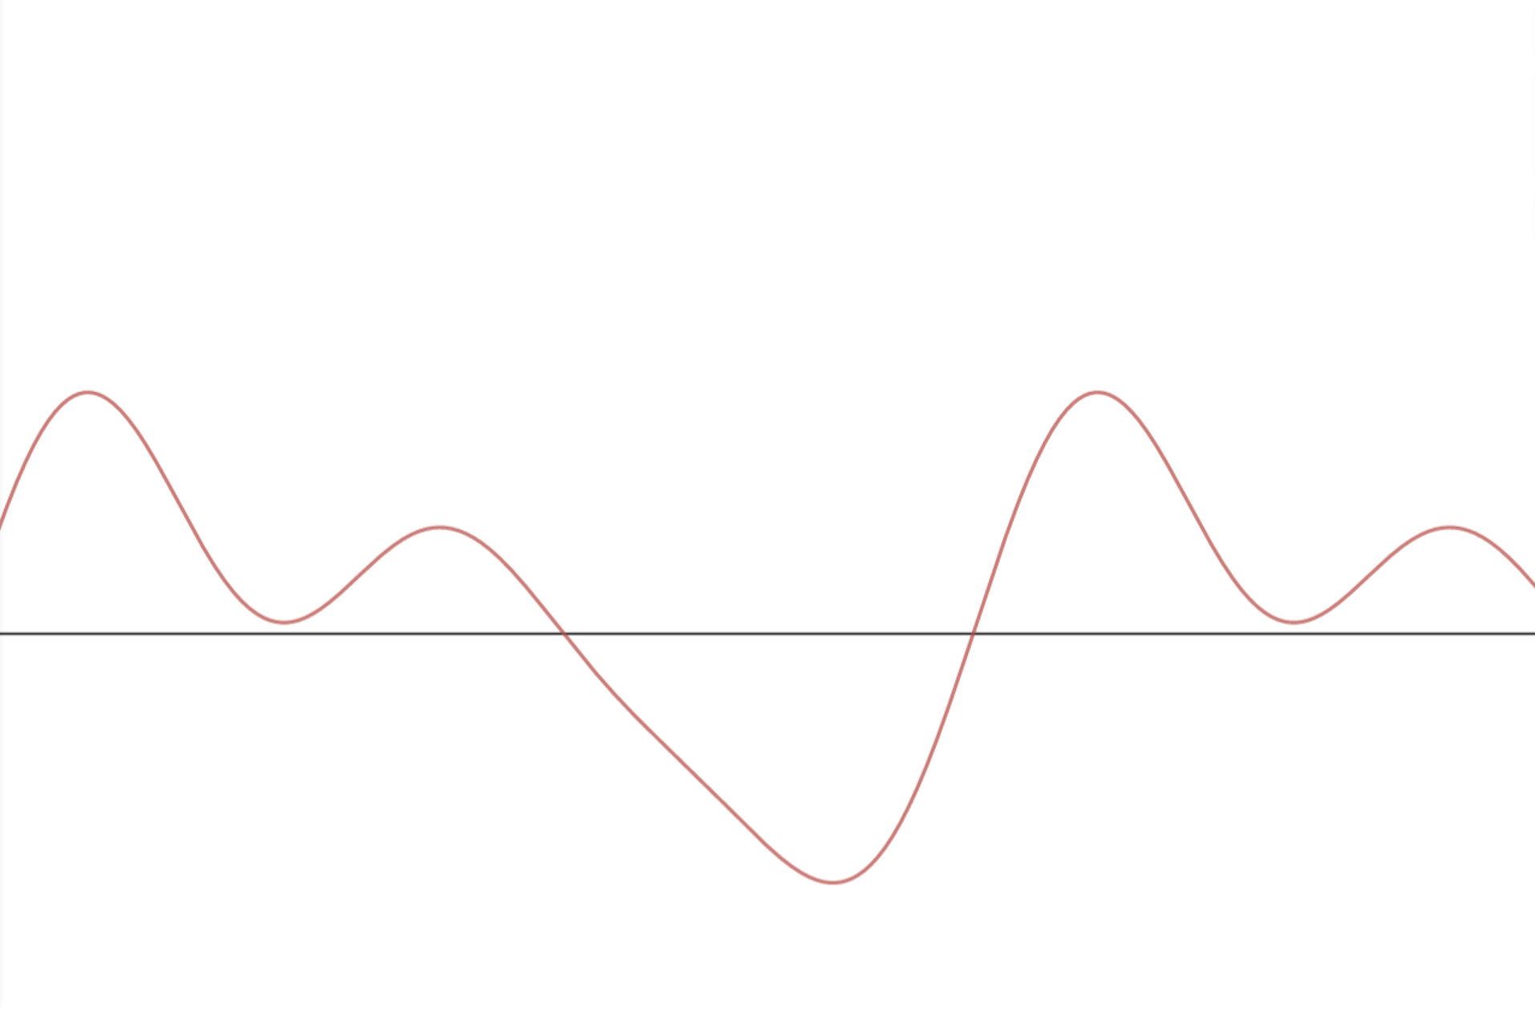
ESTIMATING SIGNS

Slide 7
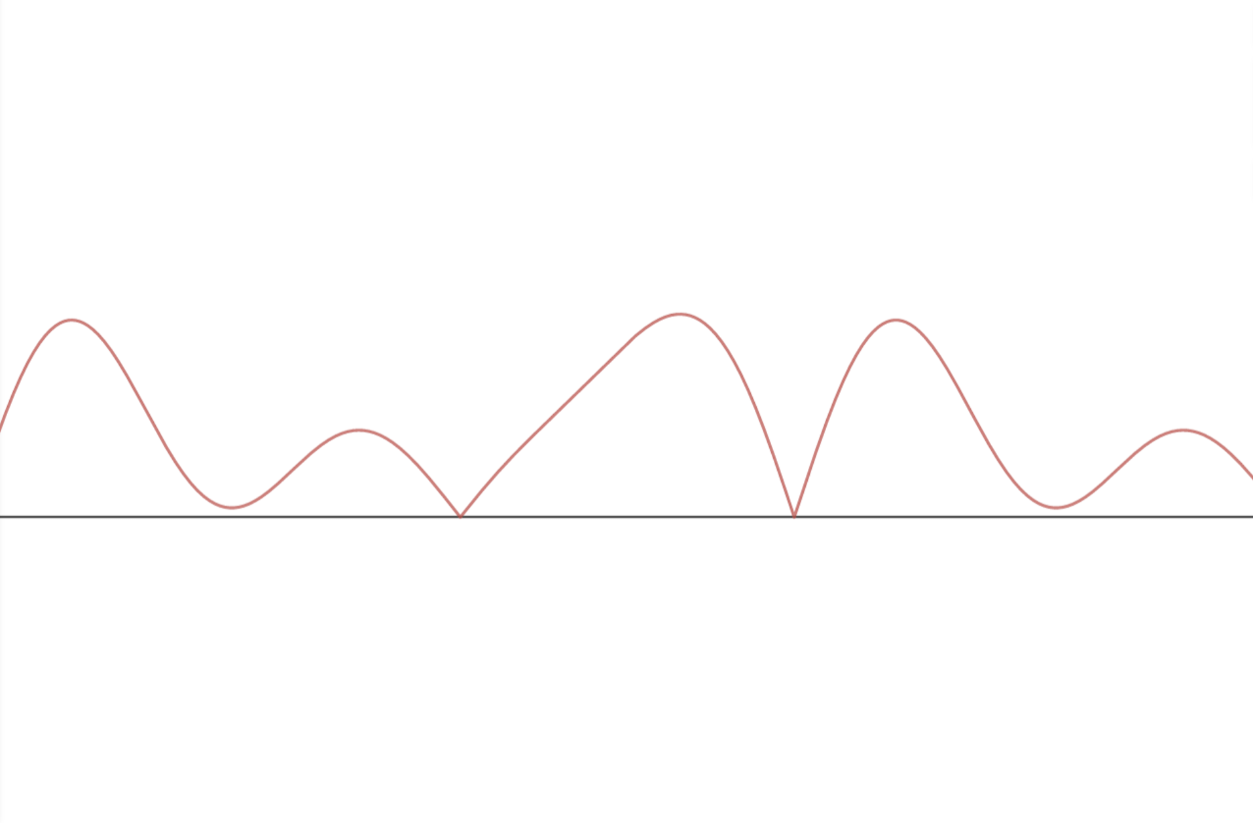
ESTIMATING SIGNS

Slide 8
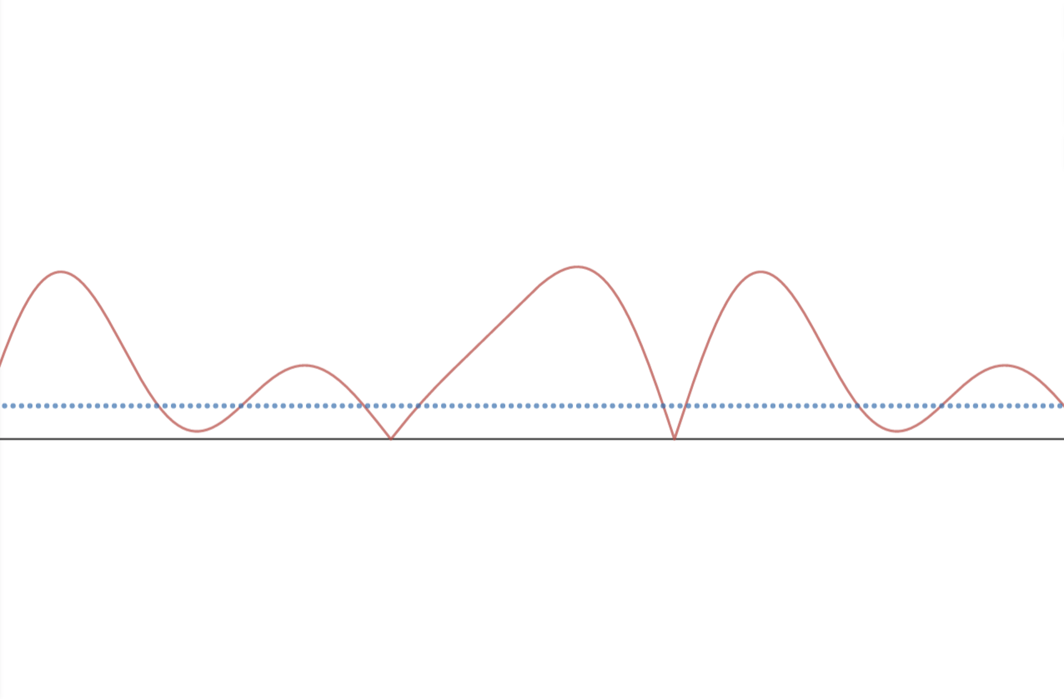
ESTIMATING SIGNS

Slide 9
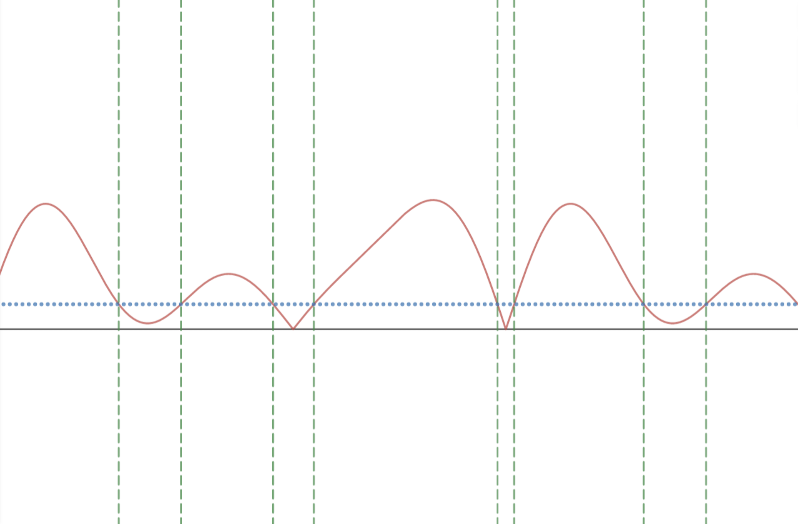
ESTIMATING SIGNS

Slide 10
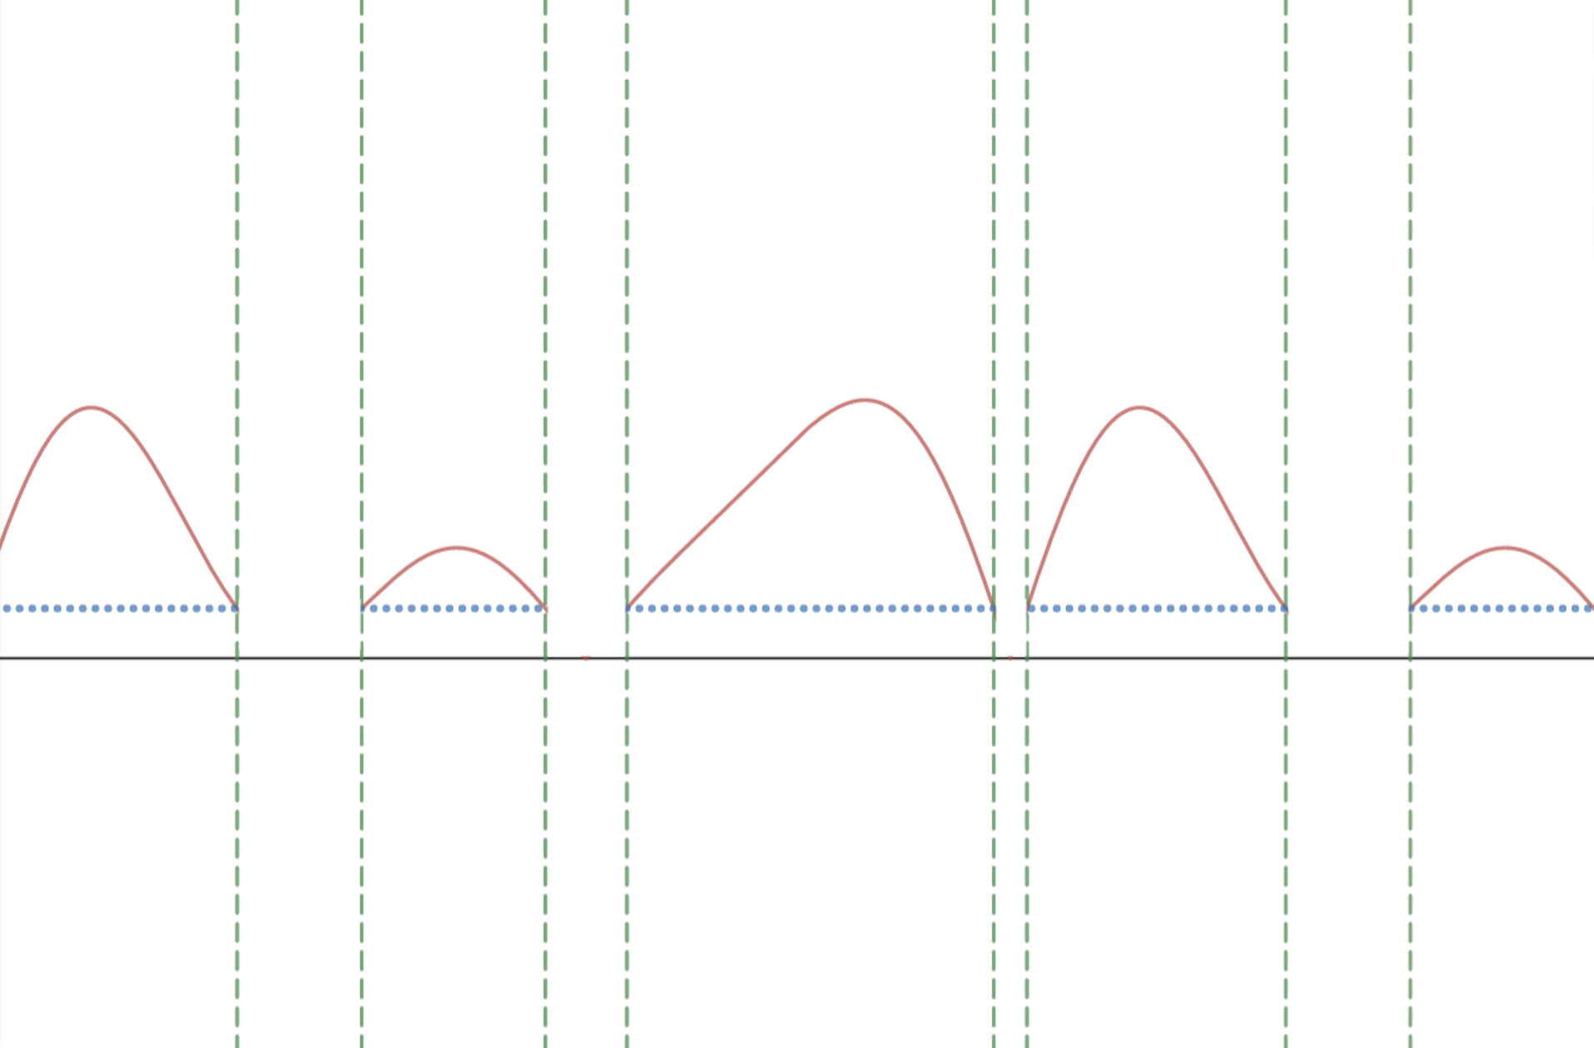
ESTIMATING SIGNS
segment 1
segment 2
segment 3
segment 4
segment 5

Slide 11
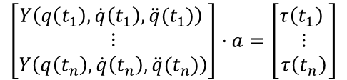
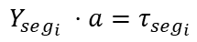
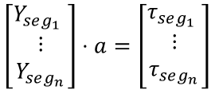
ESTIMATING SIGNS
We would like to treat each segment independently.
$$\left[\begin{matrix}Y\left(q\left(t_{1}\right), \dot{q}\left(t_{1}\right), \ddot{q}(t_{1})\right) \\ ⋮ \\ Y\left(q\left(t_{n}\right), \dot{q}\left(t_{n}\right), \ddot{q}(t_{n})\right)\end{matrix}\right]⋅a=\left[\begin{matrix}τ\left(t_{1}\right) \\ ⋮ \\ τ\left(t_{n}\right)\end{matrix}\right]$$
We can group rows that refer to the same segment in the same $Y$ block.
$$\left[\begin{matrix}Y_{seg_{1}} \\ ⋮ \\ Y_{seg_{n}}\end{matrix}\right]⋅a=\left[\begin{matrix}τ_{seg_{1}} \\ ⋮ \\ τ_{seg_{n}}\end{matrix}\right]$$
So, for the $i$-th segment the problem becomes:
$$Y_{seg_{i}} ⋅a=τ_{seg_{i}}$$

Slide 12
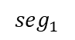
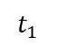
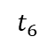
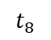
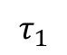
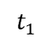
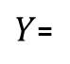
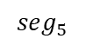
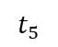
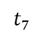
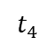
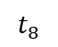
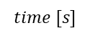
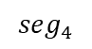
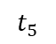
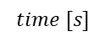
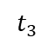
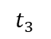
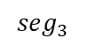
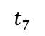
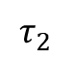
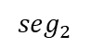
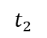
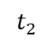
$$t_{1}$$
$${seg}_{1}$$
$${seg}_{2}$$
$${seg}_{3}$$
$$t_{2}$$
$$τ_{1}$$
$$time [s]$$
$$t_{3}$$
$${seg}_{4}$$
$${seg}_{5}$$
$$τ_{2}$$
$$t_{4}$$
$$time [s]$$
$Y$=
$$t_{1}$$
$$t_{2}$$
$$t_{3}$$
$$t_{4}$$
$$t_{5}$$
$$t_{6}$$
$$t_{7}$$
$$t_{8}$$
$$t_{5}$$
We would like to treat each segment independently also when they belong to different joint torques and they could possibly be simultaneous.
$$t_{6}$$
$$t_{7}$$
$$t_{8}$$

Slide 13
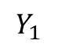
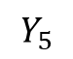
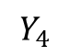
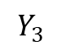
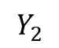
$$Y_{1}$$
$${seg}_{1}$$
$${seg}_{2}$$
$${seg}_{3}$$
$$τ_{1}$$
$$Y_{2}$$
$$time [s]$$
$${seg}_{4}$$
$${seg}_{5}$$
$$τ_{2}$$
$$Y_{3}$$
$$time [s]$$
$Y$=
$$Y_{4}$$
Each segment is independent!
$$Y_{5}$$

Slide 14
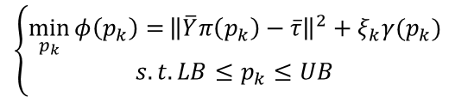
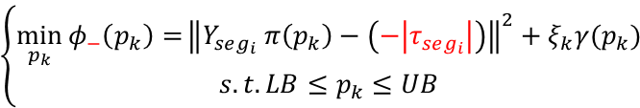
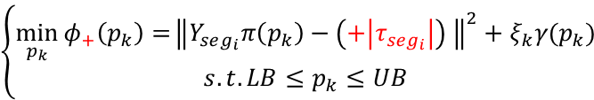
ESTIMATING SIGNS
For each segment we can solve the sequent problem by using the PBPR algorithm.
$$\left\{\begin{aligned}\min_{p_{k}}{φ\left(p_{k}\right)=}{\left\|\overline{Y}π\left(p_{k}\right)−\overline{τ}\right\|}^{2}+ξ_{k}γ(p_{k}) \\ s.t. LB≤p_{k}≤UB\end{aligned}\right.$$
2 possibilities:
$$\left\{\begin{aligned}\min_{p_{k}}{φ_{+}\left(p_{k}\right)=}{\left\|Y_{seg_{i}}π\left(p_{k}\right)−\left(+\left|τ_{seg_{i}}\right|\right) \right\|}^{2}+ξ_{k}γ(p_{k}) \\ s.t. LB≤p_{k}≤UB\end{aligned}\right.$$
$$\left\{\begin{aligned}\min_{p_{k}}{φ_{−}\left(p_{k}\right)=}{\left\|Y_{seg_{i}} π\left(p_{k}\right)−\left(−\left|τ_{seg_{i}}\right|\right)\right\|}^{2}+ξ_{k}γ(p_{k}) \\ s.t. LB≤p_{k}≤UB\end{aligned}\right.$$
We expect that when we solve the problem with the wrong sign, the value of $φ$ is larger.

Slide 15
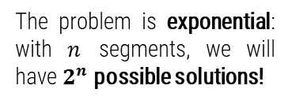
BUILDING THE TREE
If we analyse the segments in order, we will obtain the sequent tree:
segments 1, 2 and 3
segments 1 and 2
+ + +
+ + -
+ +
The problem is exponential: with $n$ segments, we will have $2^{n}$ possible solutions!
segment 1
+ - +
+ -
+
+ - -
. . .
-
- + +
- +
- + -
- -
- - +
- - -

Slide 16
PRUNING THE TREE
We need a strategy to expand only promising branches:
We expanded only the $k$ best branches (with the lower loss).
segment 1
+
-

Slide 17

PRUNING THE TREE
We need a strategy to expand only promising branches:
with $k=3$
segments 1 and 2
+ +
segment 1
+ -
+
-
- +
- -

Slide 18

PRUNING THE TREE
We need a strategy to expand only promising branches:
segments 1, 2 and 3
segments 1 and 2
+ + +
+ + -
. . .
+ +
segment 1
+ - +
+ -
+
+ - -
In our experiments we chose $k=5$
-
- +
- -
- - +
- - -

Slide 19
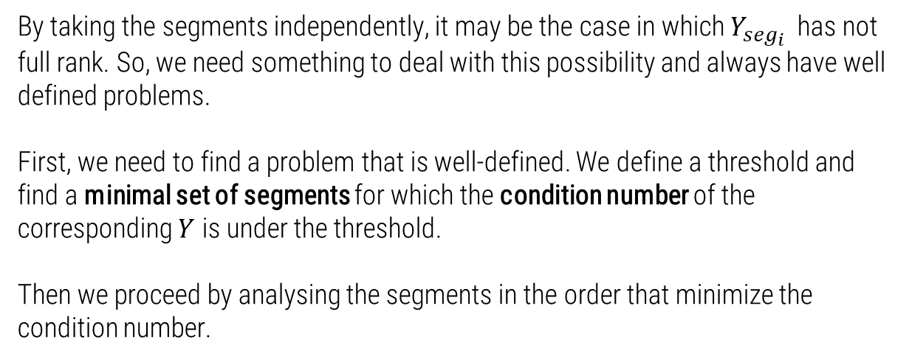
CONDITIONING THE PROBLEMS
By taking the segments independently, it may be the case in which $Y_{seg_{i}}$ has not full rank. So, we need something to deal with this possibility and always have well defined problems.
First, we need to find a problem that is well-defined. We define a threshold and find a minimal set of segments for which the condition number of the corresponding $Y$ is under the threshold.
Then we proceed by analysing the segments in the order that minimize the condition number.

Slide 20
CONDITIONING THE PROBLEMS
Let’s suppose that we found a set of 3 segments for having a problem well-defined.
+ + +
+ + - +
+ + - + +
+ + -
+ + -
+ + - -
+ + - + -
+ - +
+ - +
…
+ - + +
+ + - - +
+ - -
+ - + -
+ + - - -
- + +
- + - +
+ - + - +
- + -
- + -
- + - -
+ - + - -
- - +
- - -
The next segment is the one that added to the others minimizes the condition number.

Slide 21
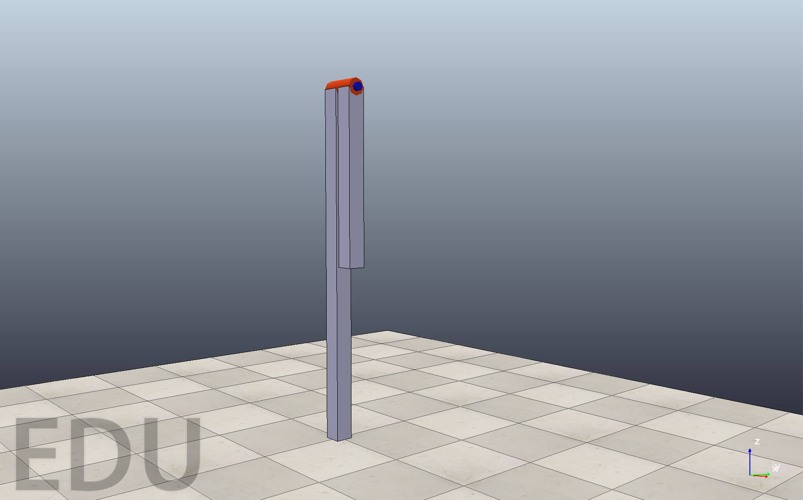
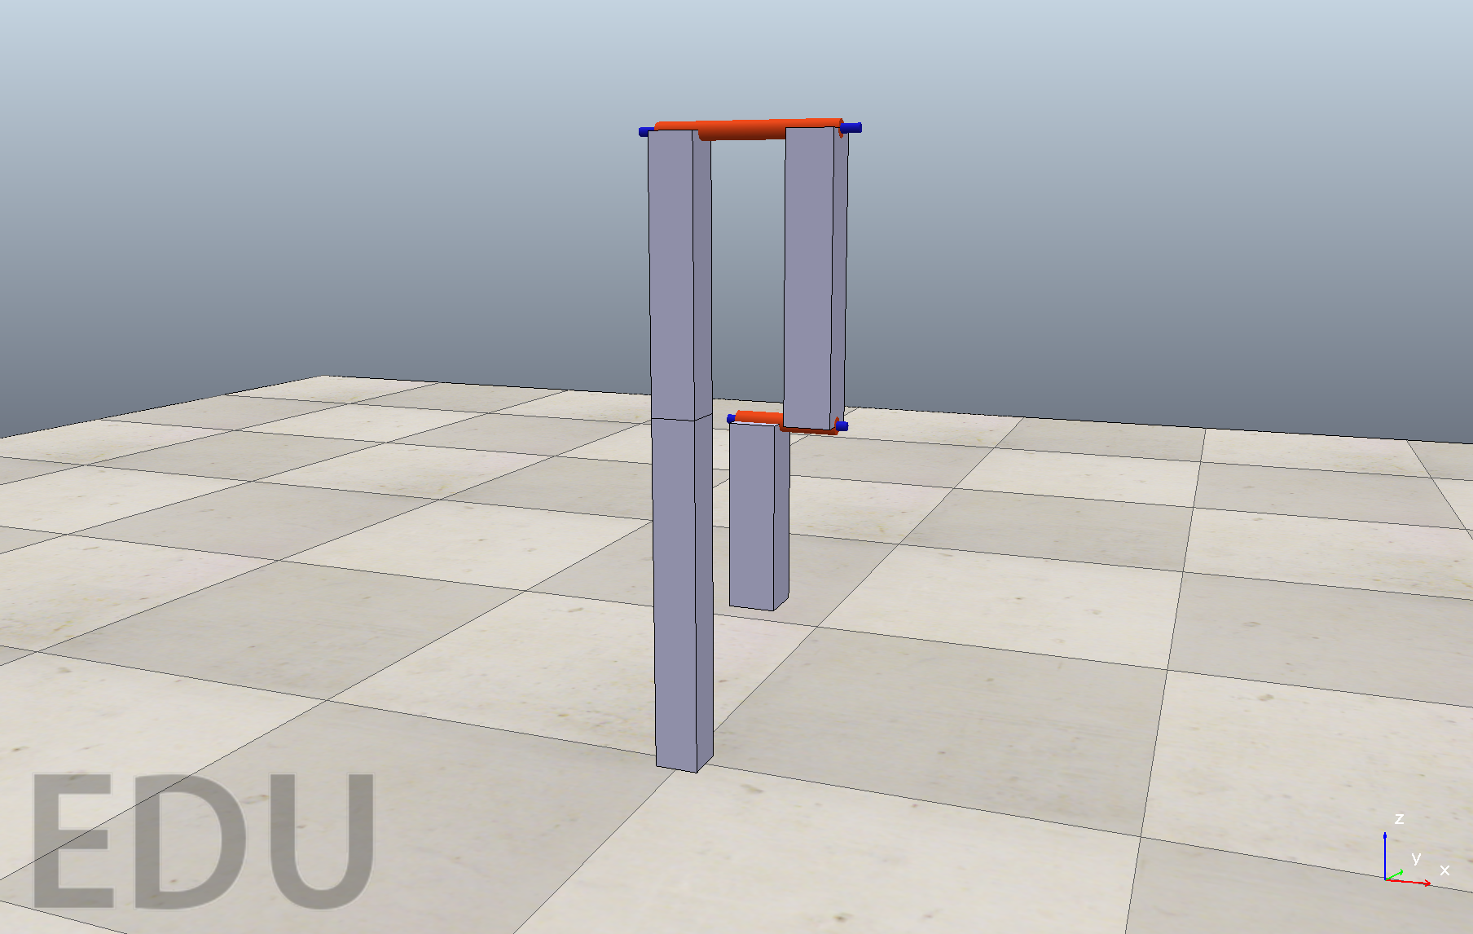
RESULTS
Experiments on 1R and 3R robot

Slide 22
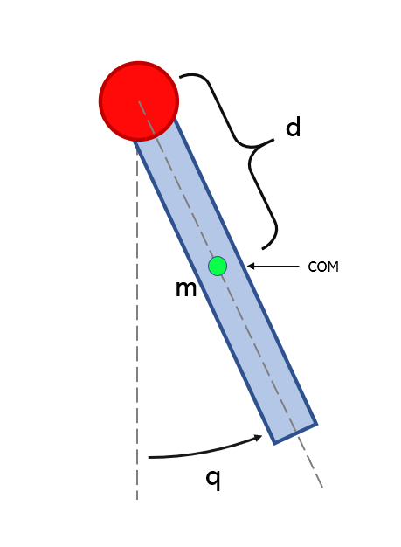

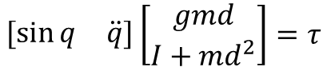

1R ROBOT UNDER GRAVITY
Dynamic Model
$$gmd\sin{q}+\left(I+md^{2}\right)\ddot{q}=τ$$
$$\left[\begin{matrix}\sin{q} & \ddot{q}\end{matrix}\right]\left[\begin{matrix}gmd \\ I+md^{2}\end{matrix}\right]=τ$$
$$Y⋅a=τ$$

Slide 23




1R ROBOT UNDER GRAVITY
Experiment 1
Coefficients error is: $1.6401⋅{10}^{−5}$

Slide 24




1R ROBOT UNDER GRAVITY
Experiment 2
Coefficients error is: $4.2554⋅{10}^{−2}$

Slide 25






1R ROBOT UNDER GRAVITY
Experiment 3
$$q_{j}\left(t\right)=\sum_{l=1}^{L}{\frac{a_{l,j}}{lω_{f}}\sin{(lω_{f}t)}−\frac{b_{l,j}}{lω_{f}}\cos\left(lω_{f}t\right)+q_{0,j}}$$
We chose $L=5$ and $ω_{f}=0.2π$
Coefficients error is: $2.0259⋅{10}^{−6}$

Slide 26


1R ROBOT UNDER GRAVITY
Validation

Slide 27


3R SPATIAL ROBOT
Dynamic Model
$π_{1}=I_{1,yy}+m_{2}{\left(c+ d_{2}\right)}^{2}+m_{3}d_{2}^{2}+I_{2,xx}+ I_{3,xx}$
$π_{2}=m_{2}^{2}\left(L_{2}−b\right)+m_{3}L_{2}^{2} + I_{2,yy} − I_{2,xx}$
$π_{3}= I_{3,yy}+m_{3}{\left(L_{3}− d\right)}^{2}−I_{3,xx}$
$π_{4}=m_{3}\left(L_{3}−d\right)L_{2}$
$π_{5}= I_{2,zz}+m_{2}{\left(L_{2}− b\right)}^{2}+I_{3,zz}+m_{3}\left(L_{2}^{2} + {\left(L_{3}− d\right)}^{2}\right)$
$π_{6}=m_{3} {\left(L_{3}−d\right)}^{2}+I_{3,zz}$
$π_{7}=m_{2}\left(L_{2}− b\right)\left(c+ d_{2}\right)+m_{3}L_{2}d_{2}$
$π_{8}=m_{3}\left(L_{3}− d\right)d_{2}$
$π_{9}=g_{0}m_{2}\left(L_{2}− b\right)+g_{0}m_{3}L_{2}$
$π_{10}=g_{0}m_{3}\left(L_{3}− d\right)$
The dynamic coefficients we found are:
$$Y⋅π=τ$$

Slide 28



3R SPATIAL ROBOT
Experiment 1
$$q_{j}\left(t\right)=\sum_{l=1}^{L}{\frac{a_{l,j}}{lω_{f}}\sin{(lω_{f}t)}−\frac{b_{l,j}}{lω_{f}}\cos\left(lω_{f}t\right)+q_{0,j}}$$

Slide 29


3R SPATIAL ROBOT
Experiment 1
Coefficients error is: $0.0594$

Slide 30



3R SPATIAL ROBOT
Experiment 2
$$q_{j}\left(t\right)=\sum_{l=1}^{L}{\frac{a_{l,j}}{lω_{f}}\sin{(lω_{f}t)}−\frac{b_{l,j}}{lω_{f}}\cos\left(lω_{f}t\right)+q_{0,j}}$$

Slide 31


3R SPATIAL ROBOT
Experiment 2
Coefficients error is: $3.3696⋅{10}^{−5}$

Slide 32


3R SPATIAL ROBOT
Validation

Slide 33

CONSIDERATIONS
PRO:
The pruning of the tree drastically increases the velocity of the algorithm and it is worth the risk of discarding some good solutions;
In every instant of time the algorithm deals with physically consistent hypothesis;
DRAWBACKS:
We discard under-threshold samples (which are at least 10% of the total); too short segments are discarded too; since these samples are near to zero, we can imagine that they are poorly informative.
A possible problem is when the threshold is not correctly identified, but this seldom happens, and it could be solved simply by choosing a bigger threshold;
The algorithm becomes slower and slower as the robot complexity increases!

Slide 34



EXTENSION
Applying the Algorithm to a real Robot:
Franka Emika Panda
As before, we proceeded by taking the absolute value of the torque, so to pretend that we didn't have this kind of information. At this stage we could apply our tree algorithm to estimate the signs.
By doing so, we faced a big problem: in fact, when the robot increases its complexity, the tree algorithm becomes tremendously slow and it takes days or even weeks to finish its execution.

Slide 35


RELAXING THE PROBLEM
Being unable to use the algorithm as it is, we tried to relax some constraint while solving the optimization problems of the tree.
By ignoring the constraints that ensure us physically consistent parameters we can re-write the optimization problem in the following form:
$$\left\{\begin{aligned}\min_{p_{k}}{φ\left(p_{k}\right)=}{\left\|\overline{Y}π\left(p_{k}\right)−\overline{τ}\right\|}^{2}+ξ_{k}γ(p_{k}) \\ s.t. LB≤p_{k}≤UB\end{aligned}\right. ⇒ \min_{a}{φ\left(a\right)={\left\|\overline{Y}a−\overline{τ}\right\|}^{2}}$$
And we can find the solution in closed form as:
$$a^{∗}={\overline{Y}}^{\#}\overline{τ}$$
where ${\overline{Y}}^{\#}$ is the pseudoinverse of $\overline{Y}$

Slide 36


Using this relaxed problem in the tree, and not checking for the physical meaning of each term, we end up with 2 best solutions: one the opposite of the other.
and
$$\overline{Y}a=\overline{τ}$$
$$\overline{Y}\left(−a\right)=−\overline{τ}$$
Of course only one of the two is physically consistent, and we don't know a priori which is of the two.
+ | - | - | + | - | + | +
PBPR
Algorithm
+ | - | - | + | - | + | +
- | + | + | - | + | - | -
Best signs combination +
related physically consistent dynamical parameters
choose the best by comparing the two losses
2 possibilities
The execution is much faster:
~10min for estimating the signs + the time to run 2 times the PBPR algorithm

Slide 37


FRANKA EMIKA PANDA
Results
Correctly predicted signs:
105/105
Coefficients error is: $0.3980$

Slide 38
THANK YOU
FOR YOUR ATTENTION!

